Slide 1
Ant Colony Optimization for Software Project Scheduling and Staffing with an Event-Based Scheduler
Team 12
Jaehoon Choi
Chansu Park
Phan Duy Loc
Eunji Lee
Notes:
Hello. We are Team 12. We will present the paper <Ant Colony Optimization for Software Project Scheduling and Staffing with an Event-Based Scheduler>.

Slide 2
Table of Contents
Introduction
Model description
Proposed Model
Previous Models
Event Based Scheduler (EBS)
Ant Colony Optimization (ACO) Approach
Results & Discussion
Notes:
Here is our table of contents. We will first introduce the motivation, the model authors and previous works suggested, event based scheduler, ant colony optimization, and the result with discussion.

Slide 3
1. Introduction

Slide 4
Motivation
Software Development is a people-intensive activities that has lots of dependency of tasks with different skillsets
Inefficient planning leads
Delay / Low quality of the project
Waste of human resource & budget
Maybe many of us already have experienced these problem
Therefore, software development project needs careful scheduling before start
Notes:
Nowadays, software development is main stream of the world. Unlike other works, software development is a people-intensive activities that has lots of dependency of tasks with different skillsets. There are already many examples that inefficient planning made awful results. The whole or the partial project may be delayed, or it will have quite a low quality. It also causes the waste of human resource and budget, for instance, a frequent overtime. We have also experienced a lot. It means that software development project needs careful scheduling before start.

Slide 5
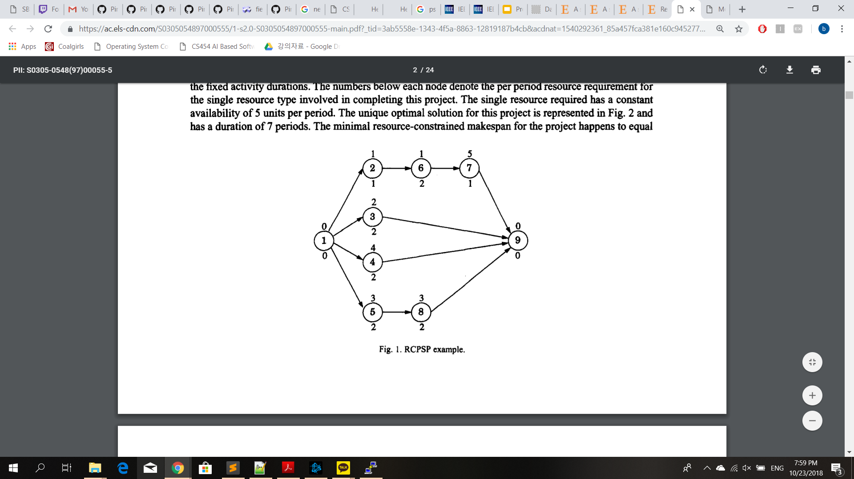
Project Scheduling Problem (PSP)
Given set of tasks in a project, in what order should the tasks be done to minimize time?
Resource constraints can be added
NP-Complete!
(Herroelen, De Reyck, Demeulemeester, 1998 W. Herroelen, B. De Reyck, E. Demeulemeester Resource-constrained project scheduling: A survey of recent developments Computers & Operations Research, 25 (1998), pp. 279-302)
Notes:
Let’s look at what is a project scheduling problem. This problem wants an optimal order of the tasks as an output, which minimizes the time.
This simple statement is already an NP complete problem, though.

Slide 6
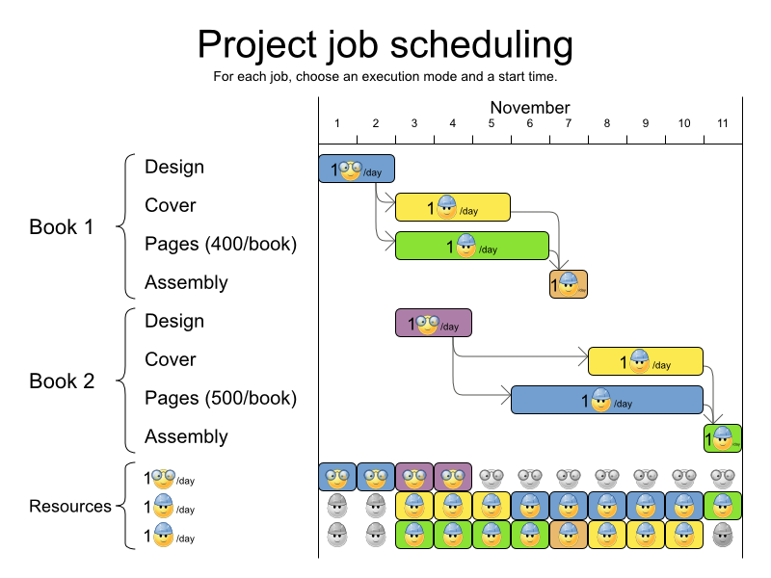
Software Project Managing Problem (SPMP)
Constraints for employees are added
Salary, working hours, skillset, etc.
On top of the PSP, add allocation of employees to each task depending on the required skills
(Alba, Enrique, and J. Francisco Chicano. "Software project management with GAs." Information Sciences 177.11 (2007): 2380-2401.)
Notes:
For the software project managing, we have more constraints about human resources. They have different salary, different maximal working hours, different skillset, and so on. Each employee will be allocated to each task, mainly depending on what skills they have.

Slide 7
Purpose of this paper
Traditional techniques: considered task scheduling and human resource allocation as two separated activities
Manual allocation of human resource → Inefficient allocation, poor management performance
Inflexible planning because of the not-carefully designed task preemption
Recently, this problem has been researched as search-based optimization problem
Notes:
About these problems, traditional techniques considered that task scheduling and human resource allocation are separated activities. Because of that, project managers allocated each employee to each task manually, which indicated the inefficient allocation and poor performance. Also, some models have the assumption that each employee can only be assigned to a sincle task at a time, which is practically incorrect. Thus many researchers have approached this problem as search-based optimization problem.

Slide 8
Purpose of this paper
Previous works suggested their model with Search-Based approach, but they didn’t take care at least one part of the following parts:
Employee (Human Resource) Allocation – RCPSP
Task Scheduling – Employee Allocation Models
Task Preemption – Previous Multiskill Scheduling Models (ex: KGA, TS)
(Relatively) Efficient Search Space – Time-Line-Based Model (a.k.a. 3DGA)
This paper suggests an effective approach for the software project planning using Event-Based Scheduler and Ant Colony Optimization, which take cares
Task Scheduling
Human Resource Allocation
While allowing task preemption and asserting relatively efficient search space.
Notes:
However, previous works have missed some important components for the software project planning problem. For instance, the resource constrained project scheduling problem model didn’t consider about employee allocation. Other model, which focused on employee allocation, didn’t care about the order of tasks. Some models made employees can only be allocated into one task; other model increased the search space rapidly. Therefore, this paper suggested a new model which adapts Event-Based Scheduler and Ant Colony Optimization technique to overcome the above weakness.

Slide 9
2. Model Description

Slide 10
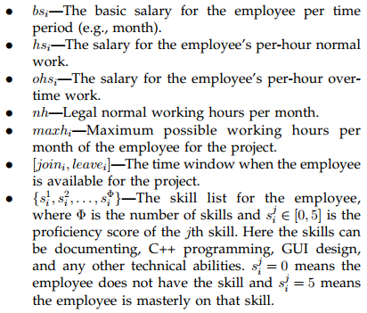
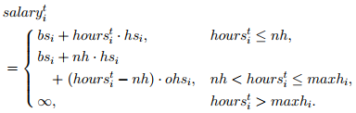

Proposed Model – Employees
There are $m$ Employees
Salary calculation for $t^{th}$ month: compare $hours_{i}^{t}$ with $nh$ and $maxh_{i}$
Notes:
Now let’s define the model. Suppose we have m employees. They have basic salary, and they also get hour-based salary which take cares about overtime. They can work at most maxh time. If some employees work longer than the normal, then they have to be rewarded by overtime salary. Also, each employee may not be available for whole term. Finally, each employees have different skills and different abilities.

Slide 11
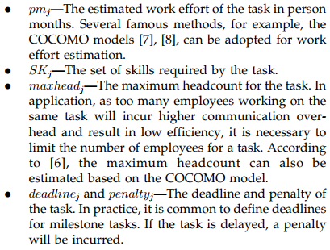
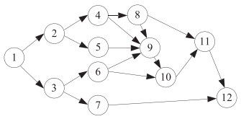

Proposed Model - Tasks
Task Precedence Graph (TPG):
Directed Acyclic Graph $G(T, A)$ where $T=\left\{t_{1},…,t_{n}\right\}$, $arc\left(i, j\right)∈A$
Notes:
About the tasks, some tasks can be started only after some prerequisites have been done. We can estimate the work effort for each tasks in person months, which requires their own skillset. We also have to regulate tasks not to consume too many employees, because of the higher communication overhead. Also, deadline exists not only for the entire project but also for each tasks. Each delay makes each corresponding penalty as a term of the money.

Slide 12



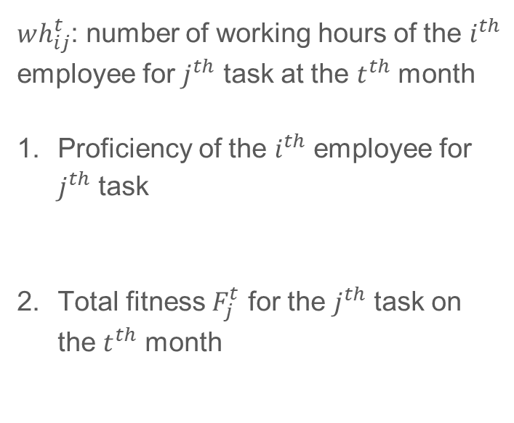
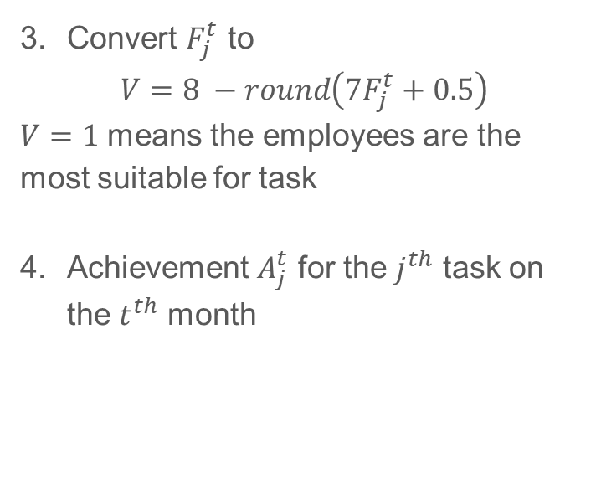
Proposed Model – Tasks
$wh_{ij}^{t}$: number of working hours of the $i^{th}$ employee for $j^{th}$ task at the $t^{th}$ month
Proficiency of the $i^{th}$ employee for $j^{th}$ task
Total fitness $F_{j}^{t}$ for the $j^{th}$ task on the $t^{th}$ month
Convert $F_{j}^{t}$ to
$$V=8 −round\left(7F_{j}^{t}+0.5\right)$$
$V=1$ means the employees are the most suitable for task
Achievement $A_{j}^{t}$ for the $j^{th}$ task on the $t^{th}$ month
Notes:
To estimate the actual duration for each task, we have to set up how much work can be done in one month. It mainly depends on the proficiency of each participating employee. We first compute the proficiency as the multiplication of the ability of each required skills. Then the fitness for the task can be computed as the ratio of the weighted sum of each employees working hours to the sum of working hours. We then take the approximate inverse of the fitness to represent the achievement A_j on the t-th month. If the summation of A_j exceeds the tasks’ estimated person month, we can say that the task is finished.

Slide 13


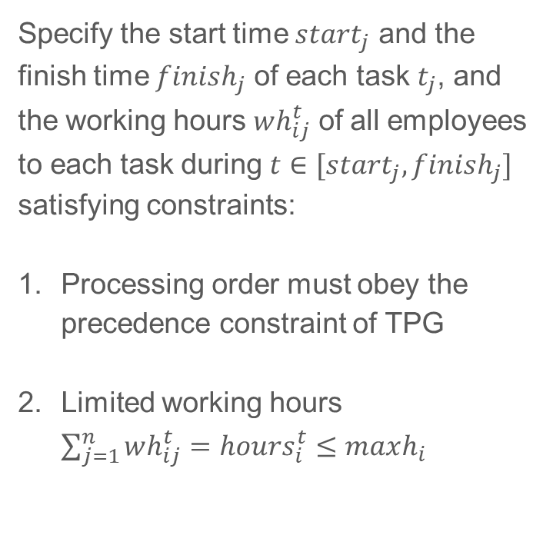
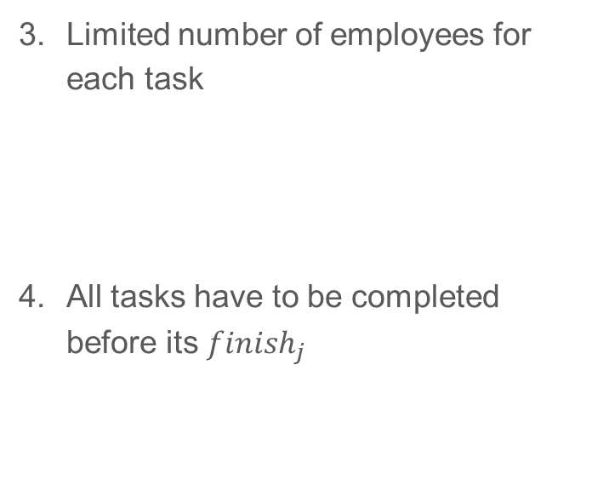
Proposed Model – Objective Function
Specify the start time $start_{j}$ and the finish time $finish_{j}$ of each task $t_{j}$, and the working hours $wh_{ij}^{t}$ of all employees to each task during $t∈[start_{j}, finish_{j}]$ satisfying constraints:
Processing order must obey the precedence constraint of TPG
Limited working hours $\sum_{j=1}^{n}{wh_{ij}^{t}=hours_{i}^{t}≤maxh_{i}}$
Limited number of employees for each task
All tasks have to be completed before its $finish_{j}$
Notes:
To order the tasks, we have to specify when each task starts and finishes, which have to satisfy the topological priority of the tasks. Also, each employee can work at most maxh hours. Each tasks have to maintain their status with not too many employees. Finally, all tasks have to be completed before its planned due, finish_j.

Slide 14

Proposed Model – Objective Function
Assume that the schedule cannot be changed
Objective: cost minimization
$$\min{f=\sum_{t=1}^{end}{salary_{i}^{t}}+\sum_{j=1}^{n}{penalty_{j}}}$$
Notes:
With these constraints, our main objective is minimizing the expected budget consumption including salary and the penalty.

Slide 15
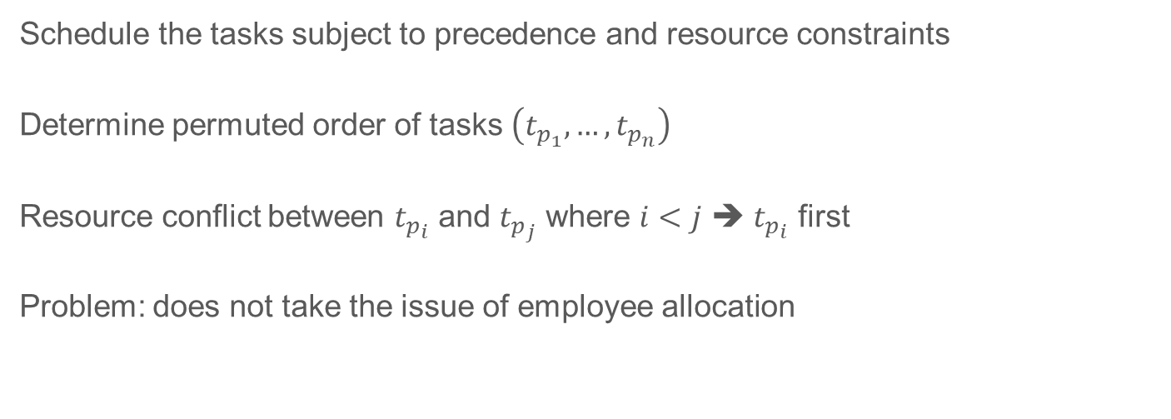
Previous Models – Resource Constrained Project Scheduling Problem (RCPSP)
Schedule the tasks subject to precedence and resource constraints
Determine permuted order of tasks $\left(t_{p_{1}}, …, t_{p_{n}}\right)$
Resource conflict between $t_{p_{i}}$ and $t_{p_{j}}$ where $i<j$ ➔ $t_{p_{i}}$ first
Problem: does not take the issue of employee allocation
Notes:
Now let’s review the previous models. The first one is resource constrained project scheduling problem. It uses the ordered task list representation to decide which task can take the resource before the other task takes. However, it doesn’t take care about human resources, so it is inadequate.

Slide 16

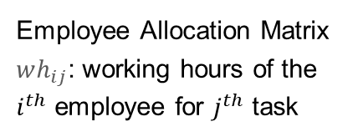
Previous Models – Employee Allocation Models
Decide how to assign employees to different tasks
Objective: minimal project duration and costs
Problem:
Lack of order, start time, finish time : unsuitable (working duration of a task depends on employees)
No consideration about resource conflict : assumed infinite resources and infinite workload
Employee Allocation Matrix
$wh_{ij}$: working hours of the $i^{th}$ employee for $j^{th}$ task
Notes:
On the other hand, employee allocation models assigns each employee to each tasks with proper working hours. It manages a 2D employee allocation matrix. However, since the duration of each task depends on what employees are participating, some tasks may wait too long to start. Also, this model cannot deal with the resource conflict. It made this model to assume that resources are unlimited and every employee can participate into an unlimited number of tasks at the same time, which is not practical.

Slide 17
Previous Models – Multiskill Scheduling Models
Extension of RCPSP where different combinations of employees are concerned
Implementation: Tabu Search (TS), Knowledge-based Genetic Algorithm (KGA)
(Example: combine task list representation and employee allocation matrix)
Problem: No task preemption (One task at one time)
Any busy employees in a team makes the whole team wait for the release
Notes:
Next, Multiskill Scheduling Models extended the resource constrained project scheduling problem which concerns different combinations of employees. This model can be actually represented by task list representation and employee allocation matrix, so it seems to resolve the issues on each model. Still, each employee can only be allocated into one task at one time. For instance, if an employee participates into the two team for task 1 and task 2, respectively, the whole team 2 have to wait when the employee works for the task 1. It reduces the resource efficiency of the project.

Slide 18
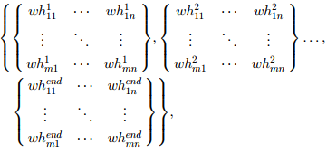
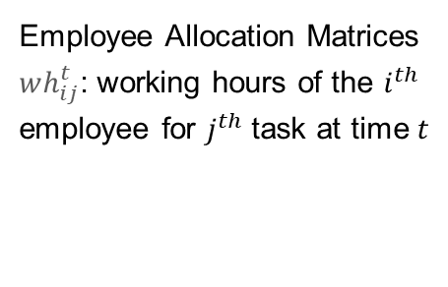
Previous Models – Time-Line-Based Model
Also called 3DGA
Make Employee Allocation Model to take care about timeline
Problem:
Workloads are assigned period-by-period: May assign two completely different groups of employees to the same task in different periods
3-dimensional data structure: search space significantly increases
Employee Allocation Matrices
$wh_{ij}^{t}$: working hours of the $i^{th}$ employee for $j^{th}$ task at time $t$
Notes:
The last previous model is time-line-based model. This model defines the employee allocation matrix for each time t. As a result, it actually enabled to overcome the disadvantages of the resource constrained project scheduling problem model and the employee allocation models. But it also increased the complexity rapidly. For instance, this approach may assign two completely different groups of employees to the same task for the consequent time. Also, since this model has three-dimensional structure, the search space is increased quite a lot. Now the next presenter will explain about the event based scheduler.

